Slide 1
Daniel Cohen
Matt Riggan
Sam Boesch

Slide 2
Introduction
The five mile dam complex needs a geodatabase to keep up with modern technology when repairing features.

Slide 3
Project Description
1) Utilize GPS and GIS to capture spatial and attribute data for the Soccer Complex at Five Mile Dam Park
2) Creating a GIS geodatabase as well as a methodology describing the creation process
3) Modeling the Soccer Complex’s soccer fields, infrastructure, and irrigation system

Slide 4
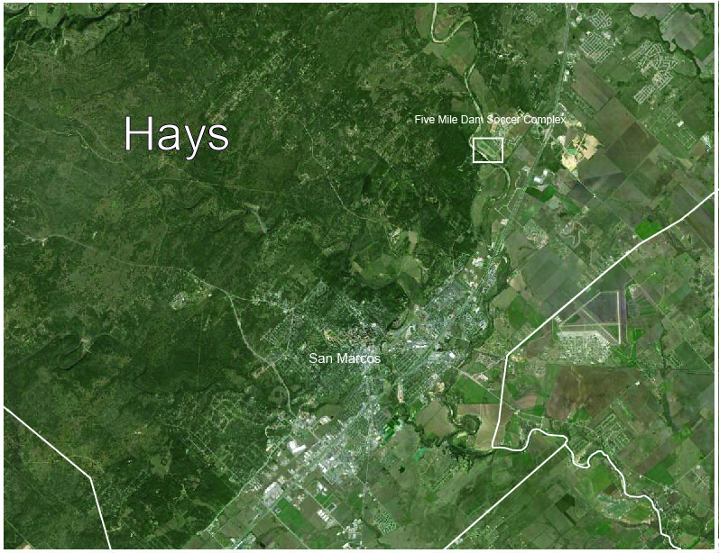
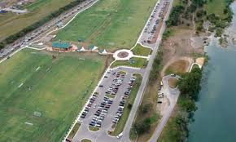
Scope
43 Acre Soccer Complex
Owned by Hays County: Maintained by the city of San Marcos

Slide 5
Project Outline
Final Deliverables:
Planning
Data Collection
Geodatabase Creation
Data Processing
Map Creation
Data Dictionary
Final Report & Database Methodology

Slide 6
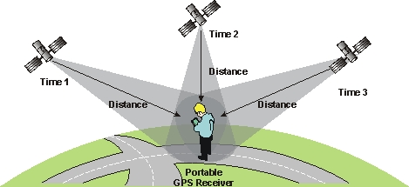
Task 1 To utilize GPS and GIS to capture spatial and attribute data for the Soccer Complex at Five Mile Dam Park
Data Dictionary
Data collection
GPS Accuracy
Difficulties: Sprinkler Heads
Field Methods
Database Creation
Data Dictionary
Data Collection
Planning
Data Processing
Map Creation
Report & Method

Slide 7
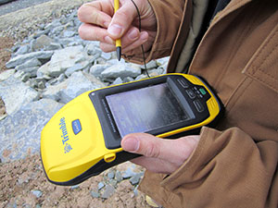
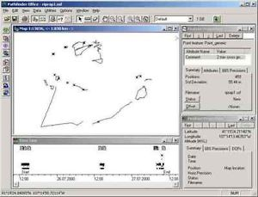
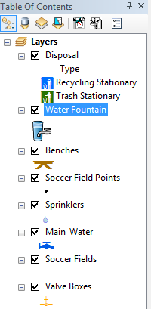
Task 2 Creating a GIS geodatabase that can be applied to future parks and recreation facilities in the future
Trimble Data to Pathfinder
Differentially Correction
Pathfinder data to ArcMap
Shapefiles are then exported as a Geodatabase
Database Creation
Planning
Data Dictionary
Data Collection
Data Processing
Map Creation
Report & Method

Slide 8
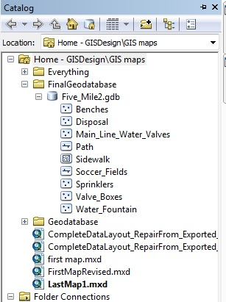
Task 2 Creating a GIS geodatabase that can be applied to future parks and recreation facilities in the future
The geodatabase created can be for future parks and recreational facilities in the future
Additional files can always be added or subtracted to account for the specific project
Database Creation
Planning
Data Dictionary
Data Collection
Data Processing
Map Creation
Report & Method

Slide 9
Task 3 Modeling the Soccer Complex’s soccer fields, infrastructure, and irrigation system
Exported data points from ArcMap to Adobe
1) Irrigation System of the Five-Mile Dam
2) Visual Representations
3) Final Deliverables
Database Creation
Planning
Data Dictionary
Data Collection
Data Processing
Map Creation
Report & Method

Slide 11
GIS Data

Slide 12
Task 2 Adobe Map #1 (soccer fields)

Slide 14
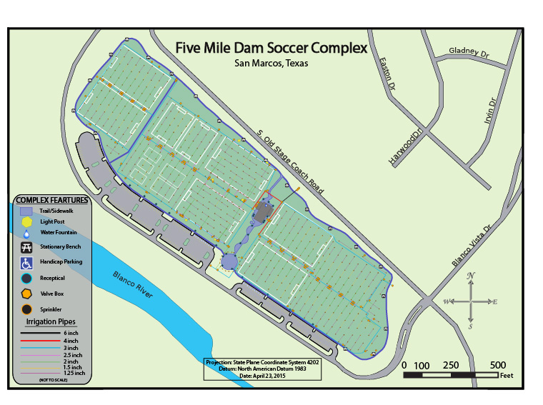
Task 2 Adobe Map #2 (other)

Slide 15
Results
Data Collection
Data Organization
Visual Aids
Final Methodology
Database Creation
Planning
Data Dictionary
Data Collection
Data Processing
Map Creation
Report & Method

